Slide 1
ER Model Continuation

Slide 2
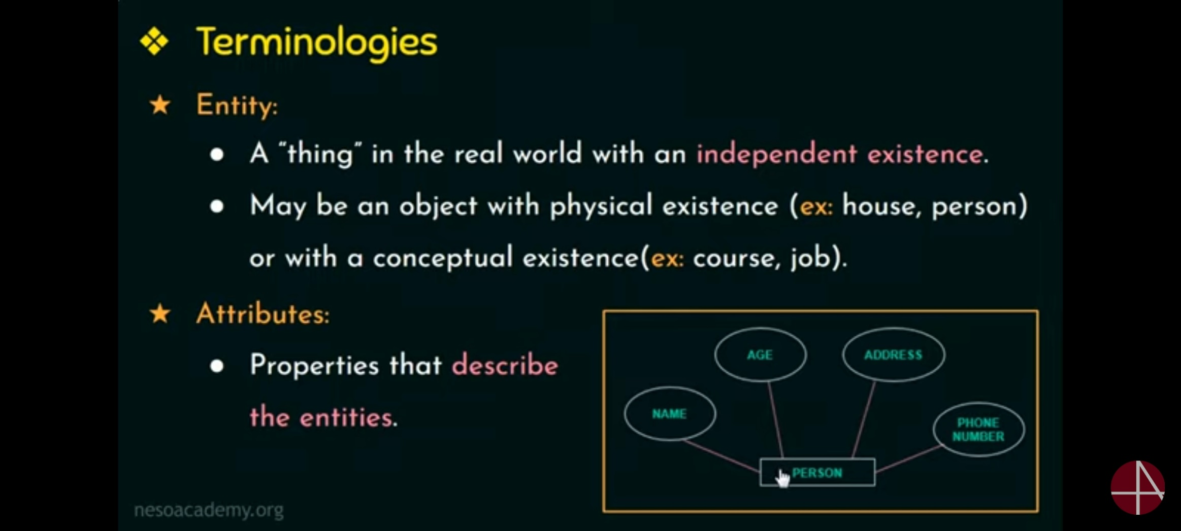

Slide 3
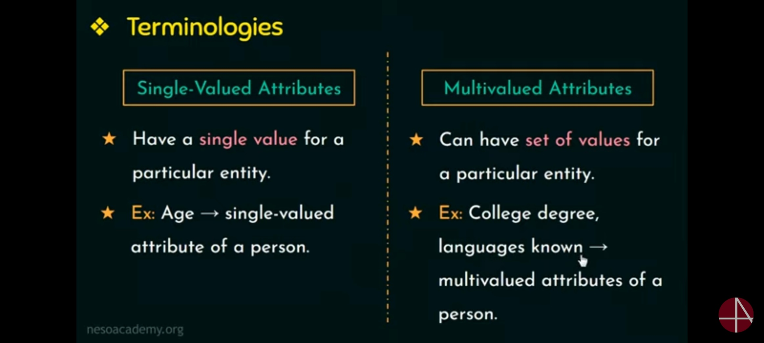

Slide 4
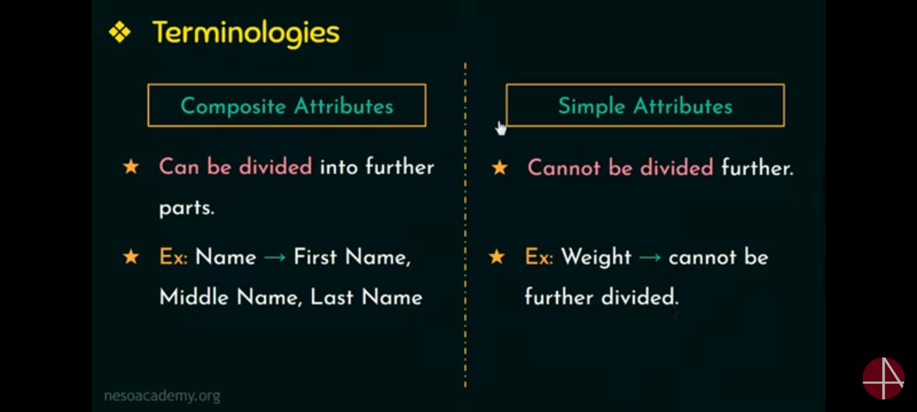

Slide 5
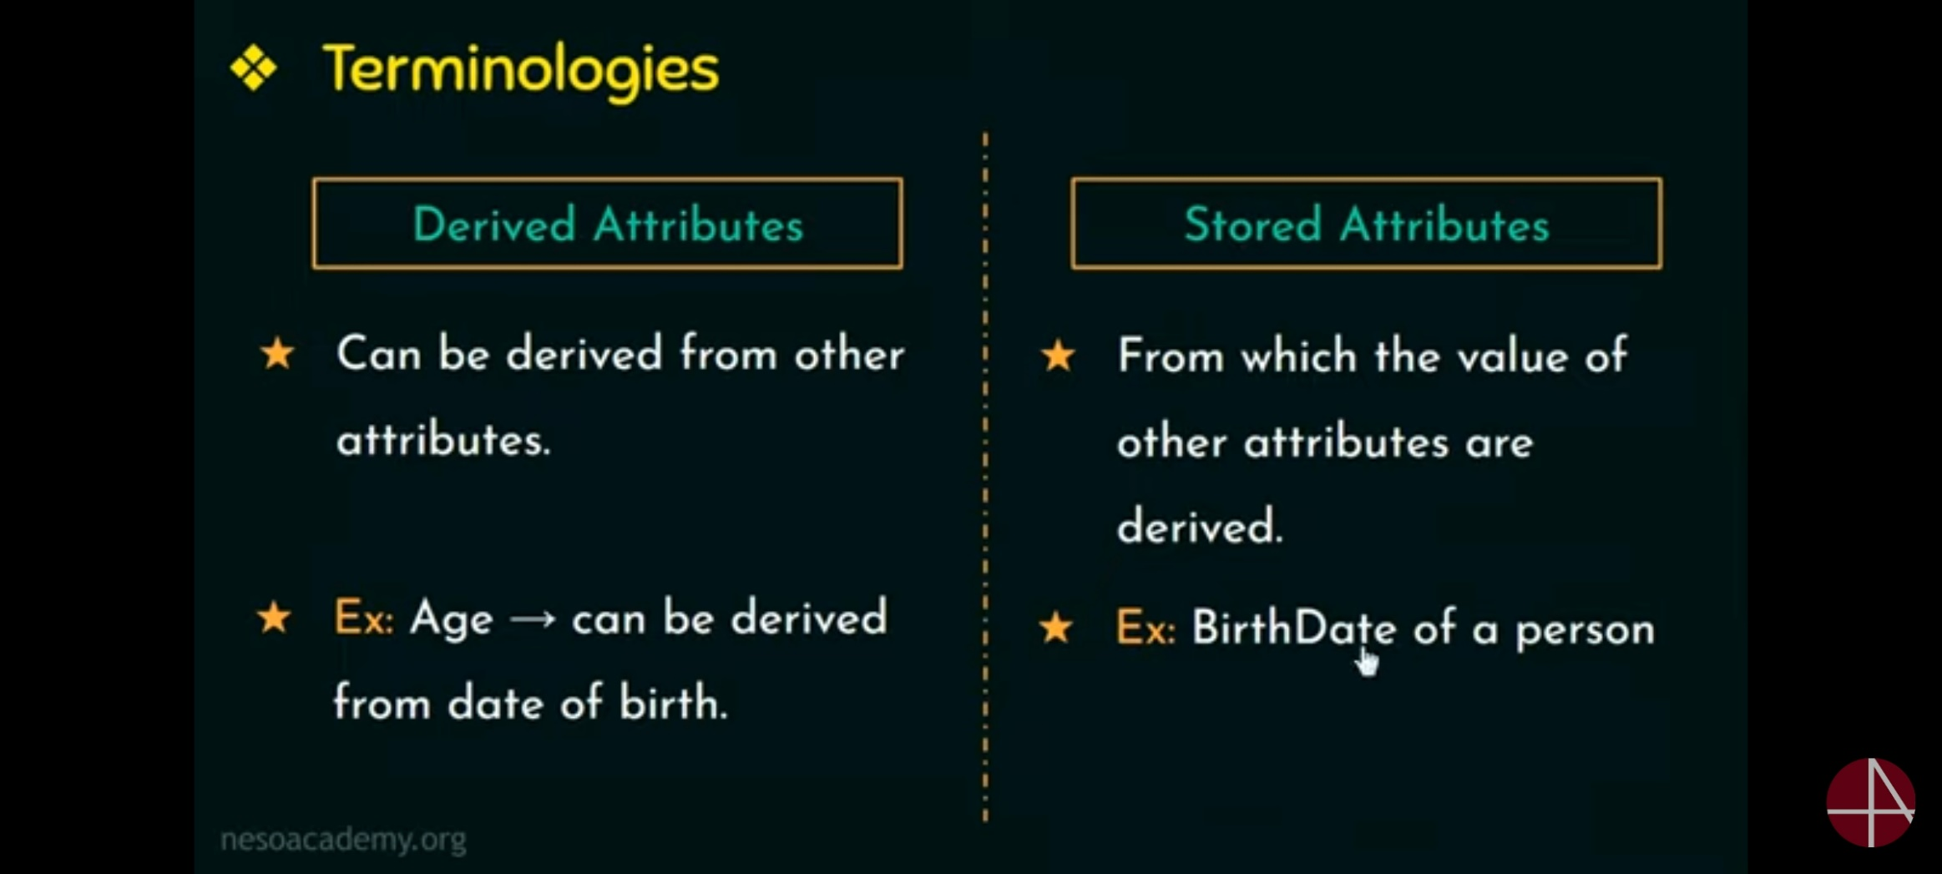

Slide 6
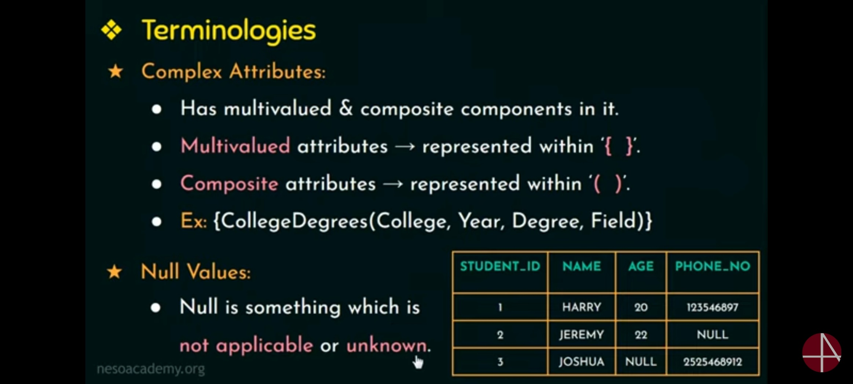

Slide 7
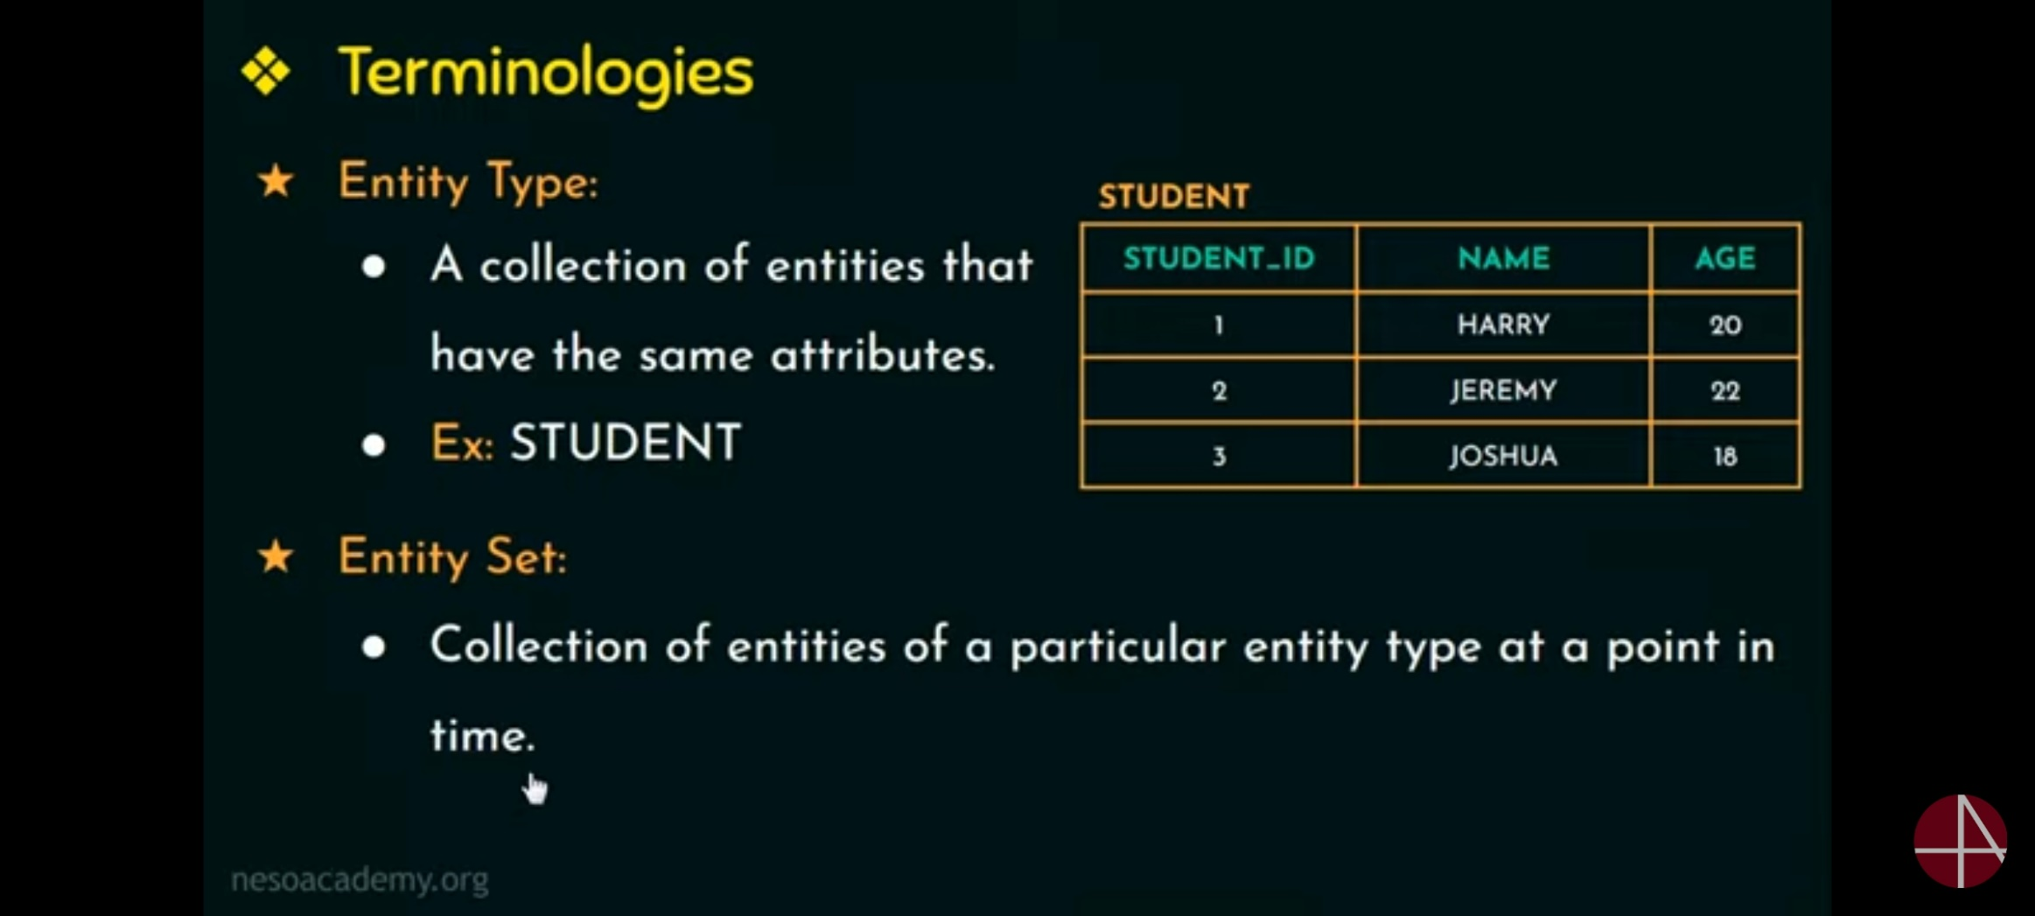

Slide 8
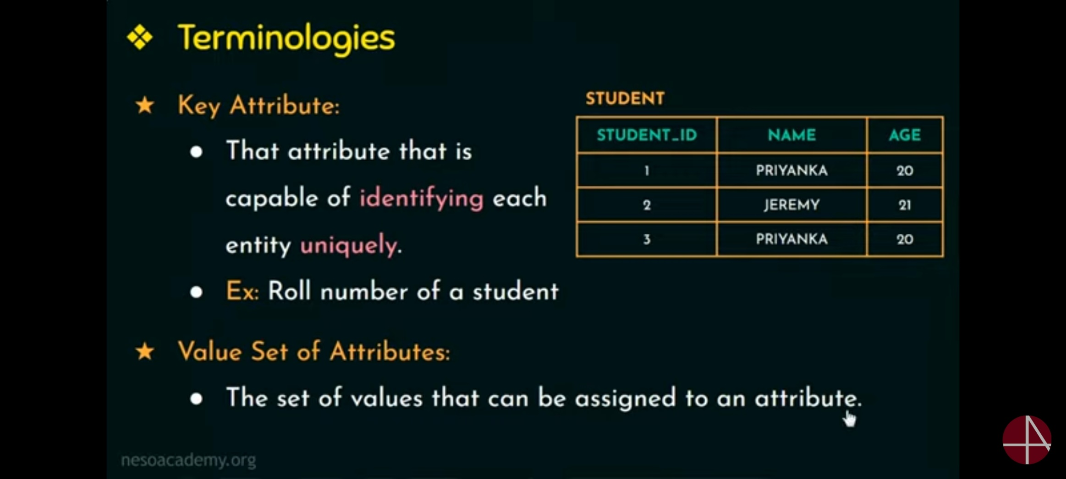

Slide 9
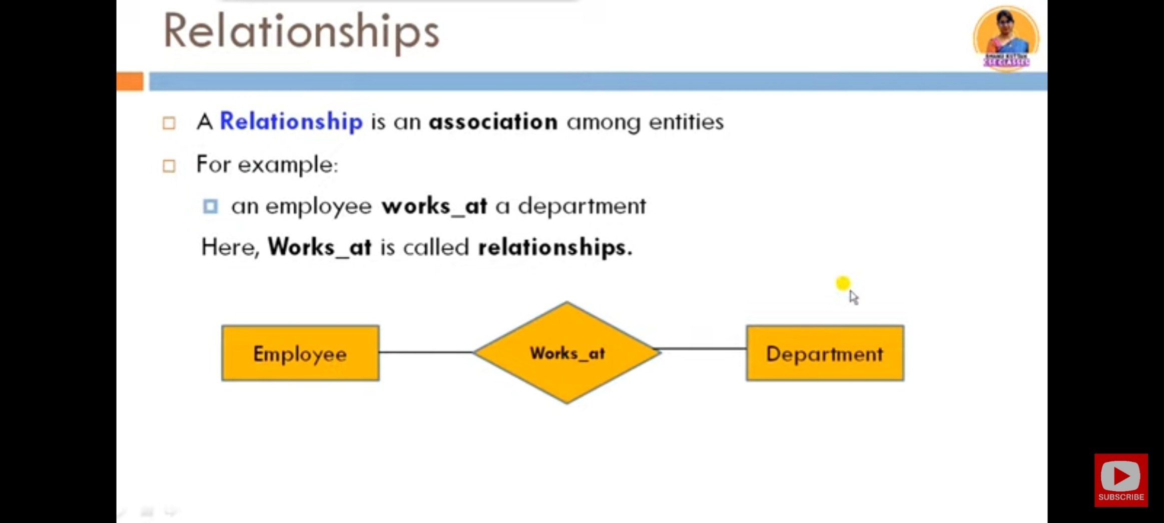

Slide 10
Classifying Relationships
Relationships are classified by their degree, connectivity, cardinality, direction, type, and existence.

Slide 11
Degree of a Relationship
The degree of a relationship is the number of entities associated with the relationship. The n-ary relationship is the general form for degree n. Special cases are the binary, and ternary ,where the degree is 2, and 3, respectively.
Binary relationships, the association between two entities is the most common type in the real world. A recursive binary relationship occurs when an entity is related to itself. An example might be "some employees are married to other employees".
A ternary relationship involves three entities and is used when a binary relationship is inadequate. Many modeling approaches recognize only binary relationships. Ternary or n-ary relationships are decomposed into two or more binary relationships.

Slide 12
Connectivity and Cardinality
The connectivity of a relationship describes the mapping of associated entity instances in the relationship. The values of connectivity are "one" or "many".
The cardinality of a relationship is the actual number of related occurrences for each of the two entities.
The basic types of connectivity for relations are: one-to-one, one-to-many, and many-to-many.

Slide 13
A one-to-one (1:1) relationship is when at most one instance of a entity A is associated with one instance of entity B.
For example, "employees in the company are each assigned their own office. For each employee there exists a unique office and for each office there exists a unique employee.

Slide 14
A one-to-many (1:N) relationships is when for one instance of entity A, there are zero, one, or many instances of entity B, but for one instance of entity B, there is only one instance of entity A. An example of a 1:N relationships is
a department has many employees
each employee is assigned to one department

Slide 15
A many-to-many (M:N) relationship, sometimes called non-specific, is when for one instance of entity A, there are zero, one, or many instances of entity B and for one instance of entity B there are zero, one, or many instances of entity A. An example is:
employees can be assigned to no more than two projects at the same time;
projects must have assigned at least three employees
A single employee can be assigned to many projects; conversely, a single project can have assigned to it many employee. Here the cardinality for the relationship between employees and projects is two and the cardinality between project and employee is three. Many-to-many relationships cannot be directly translated to relational tables but instead must be transformed into two or more one-to-many relationships using associative entities.

Slide 16
Direction
The direction of a relationship indicates the originating entity of a binary relationship. The entity from which a relationship originates is the parent entity; the entity where the relationship terminates is the child entity.
The direction of a relationship is determined by its connectivity. In a one-to-one relationship the direction is from the independent entity to a dependent entity. If both entities are independent, the direction is arbitrary. With one-to-many relationships, the entity occurring once is the parent. The direction of many-to-many relationships is arbitrary.

Slide 17
Type
An identifying relationship is one in which one of the child entities is also a dependent entity. A non-identifying relationship is one in which both entities are independent.
Existence
Existence denotes whether the existence of an entity instance is dependent upon the existence of another, related, entity instance. The existence of an entity in a relationship is defined as either mandatory or optional. If an instance of an entity must always occur for an entity to be included in a relationship, then it is mandatory. An example of mandatory existence is the statement "every project must be managed by a single department". If the instance of the entity is not required, it is optional. An example of optional existence is the statement, "employees may be assigned to work on projects".

Slide 18
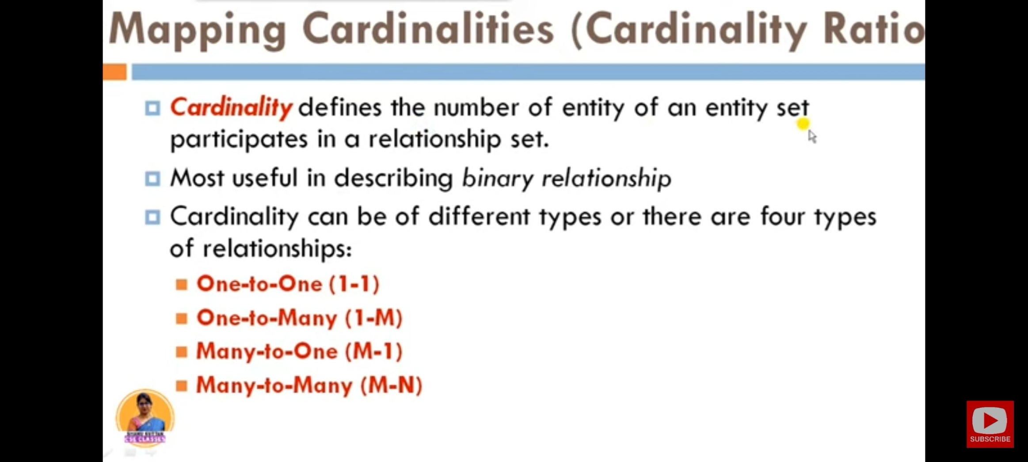

Slide 19
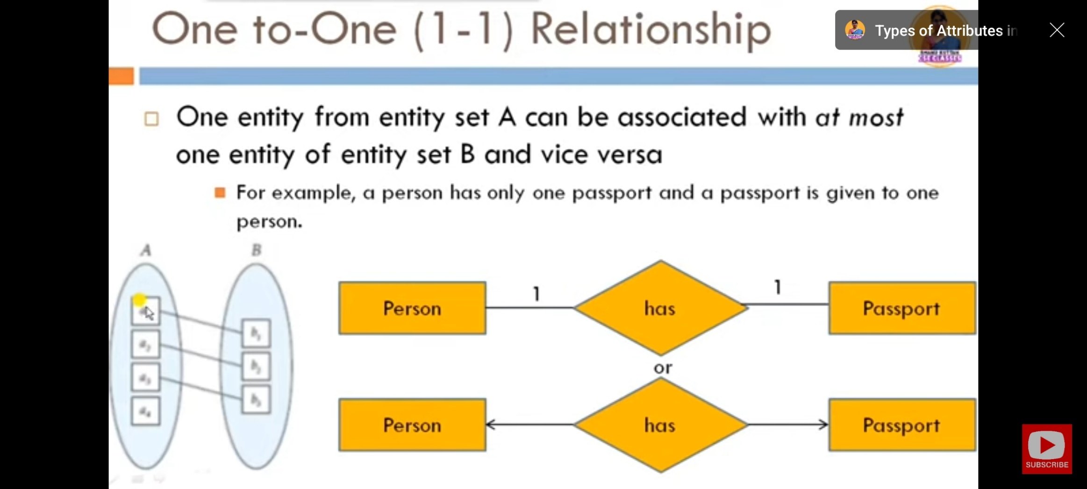

Slide 20
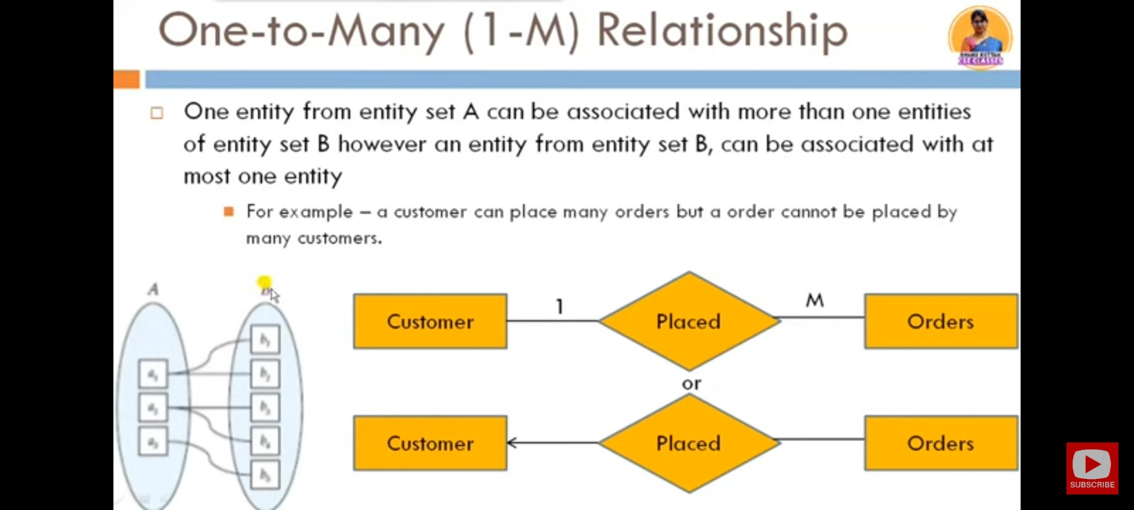

Slide 21
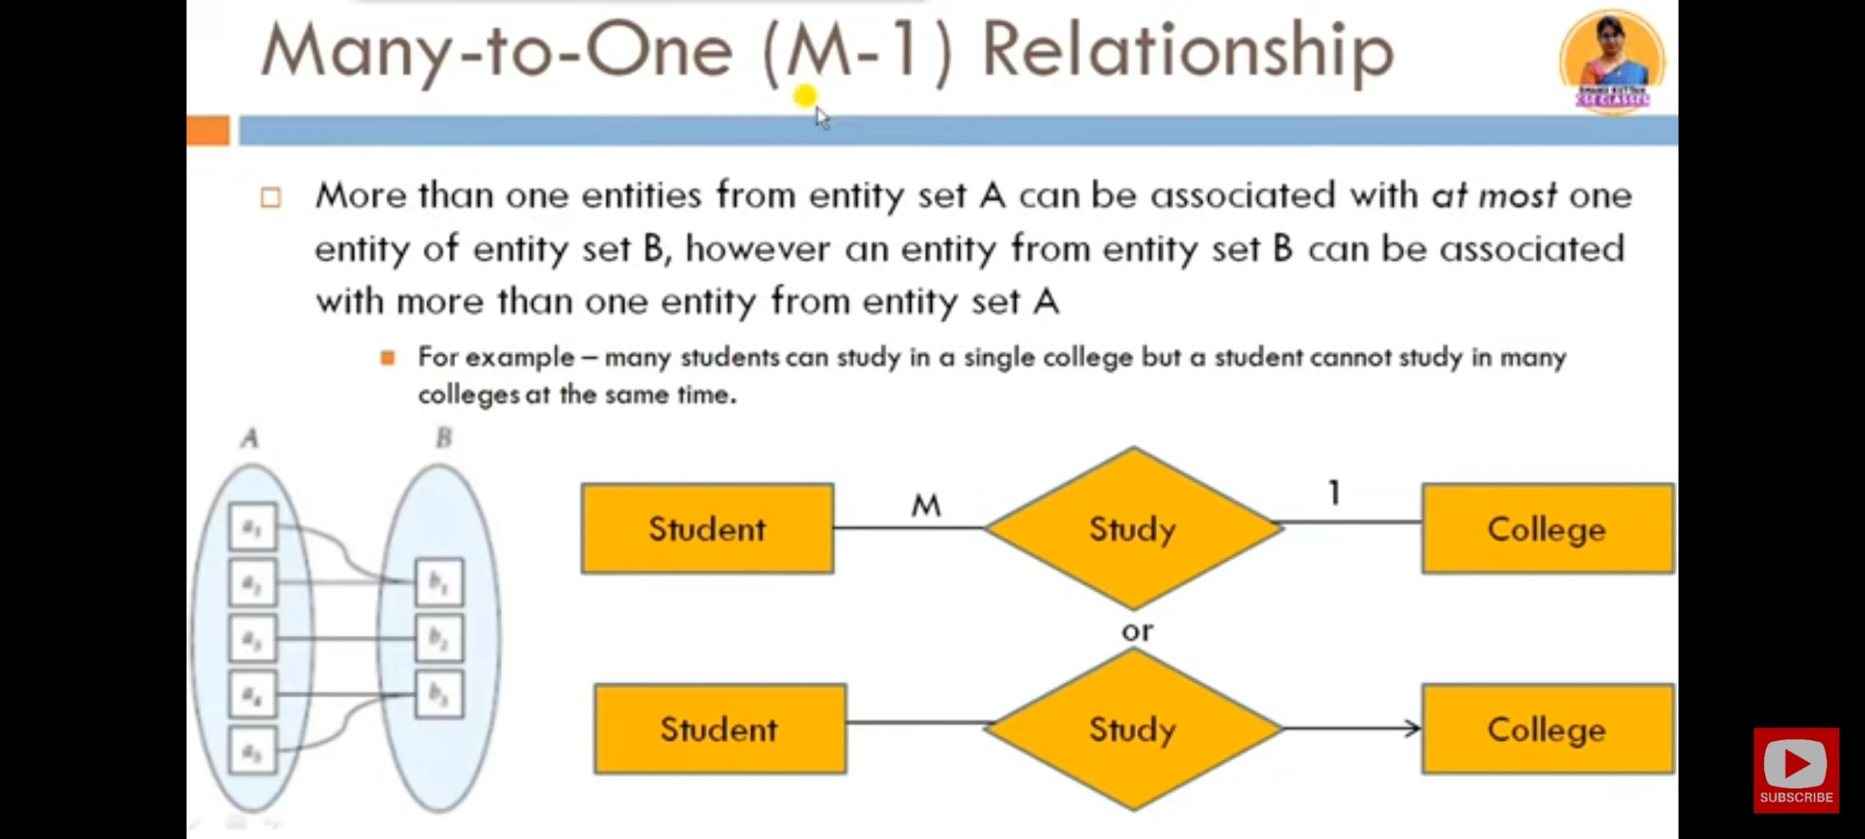

Slide 22
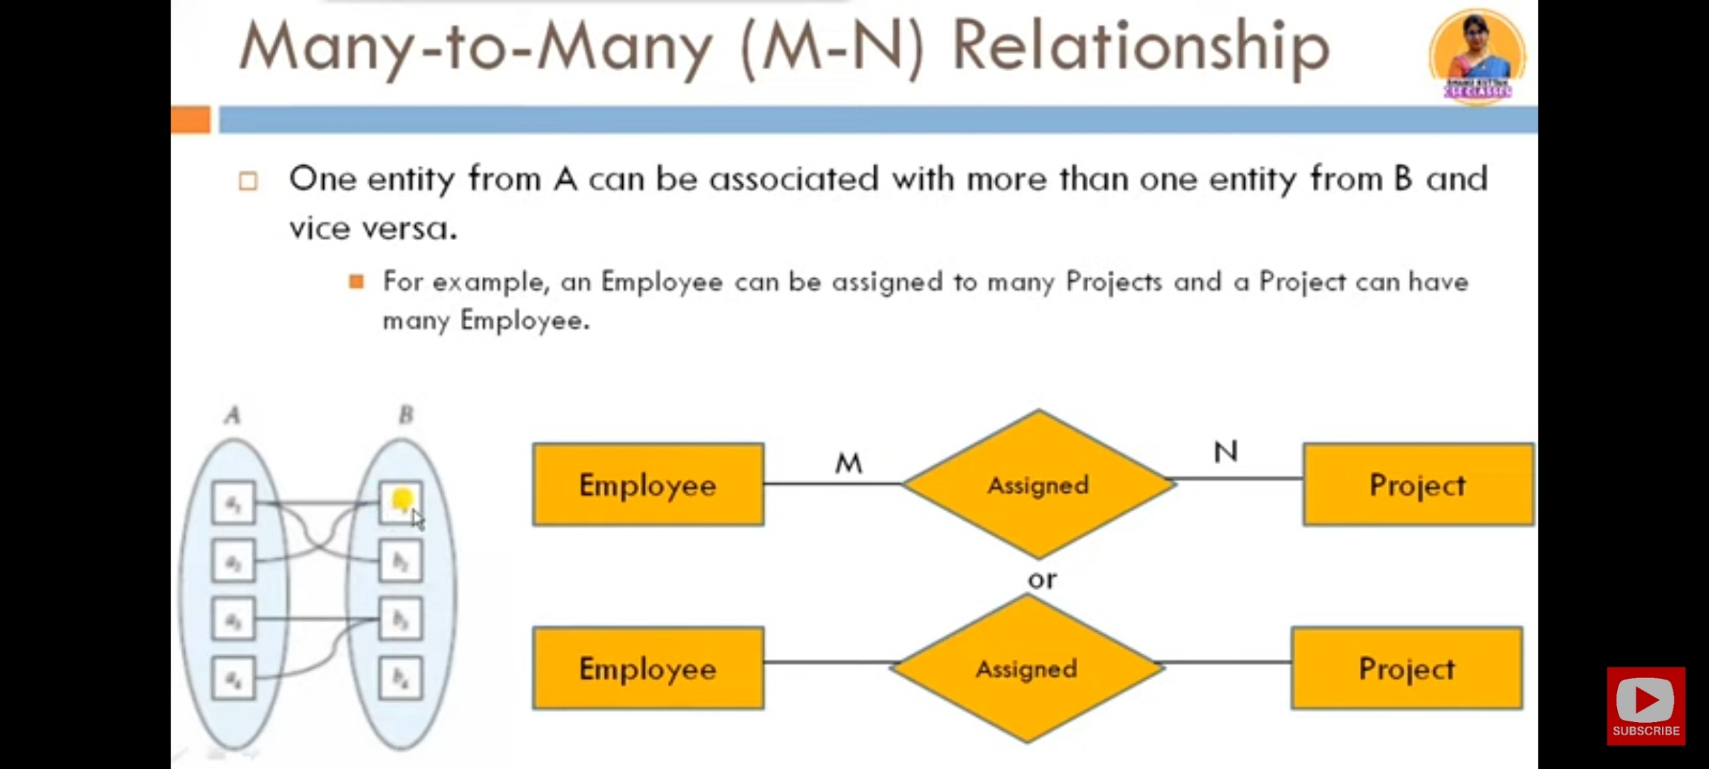

Slide 23
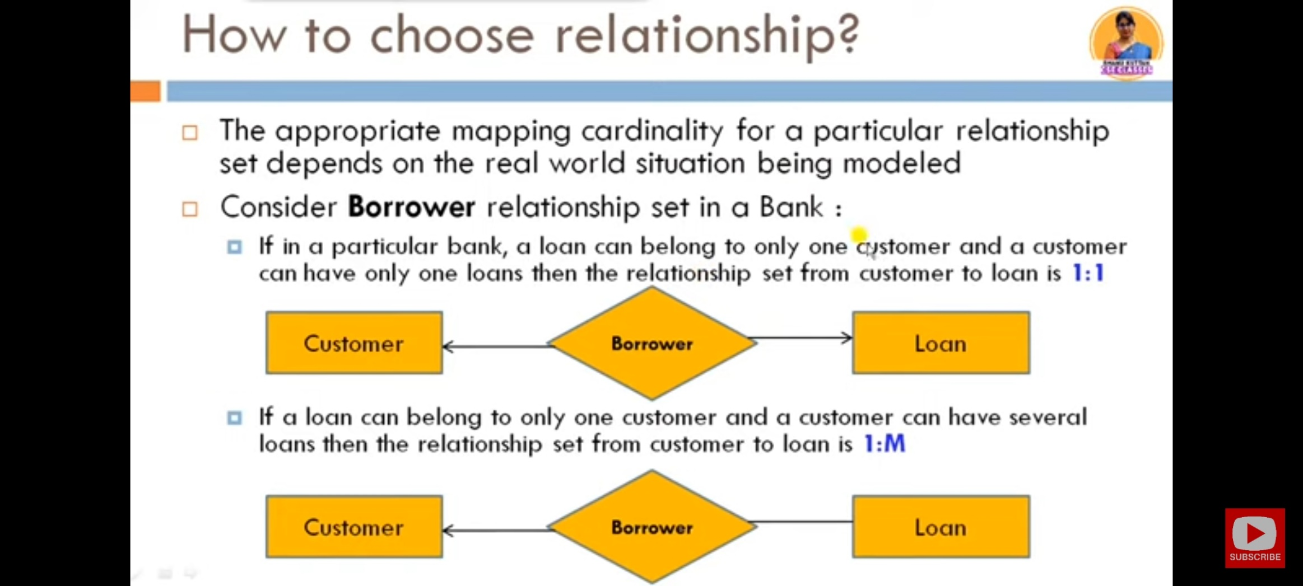

Slide 24
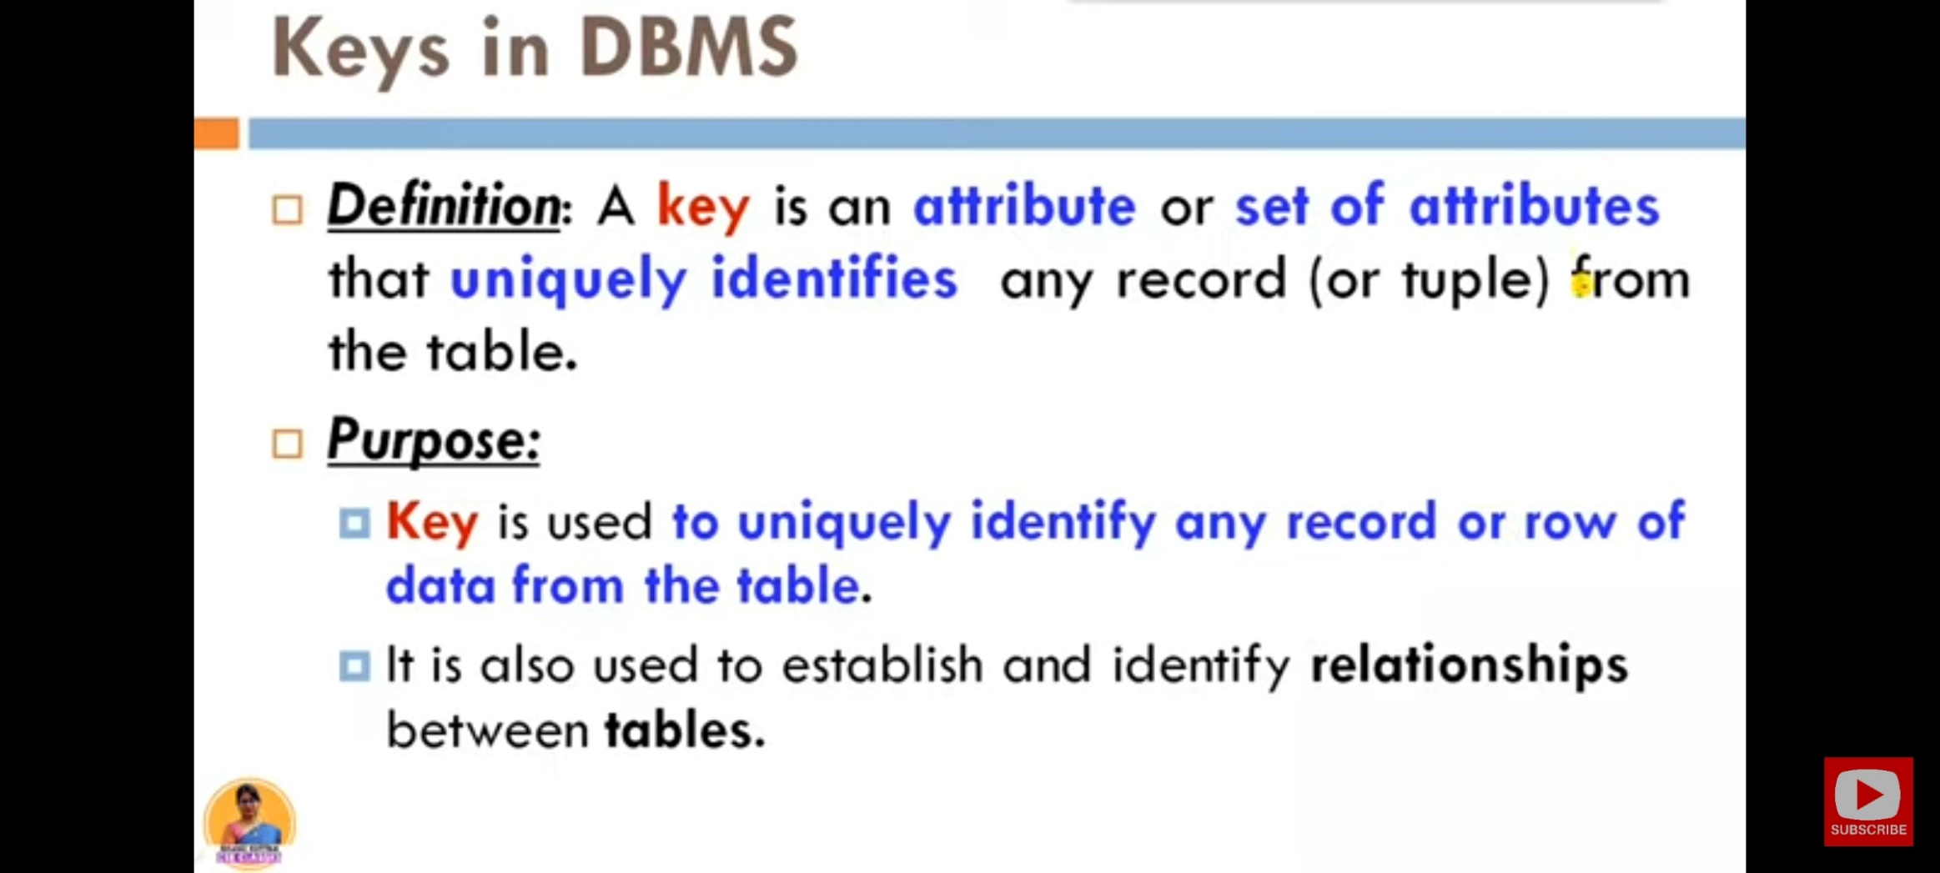

Slide 25
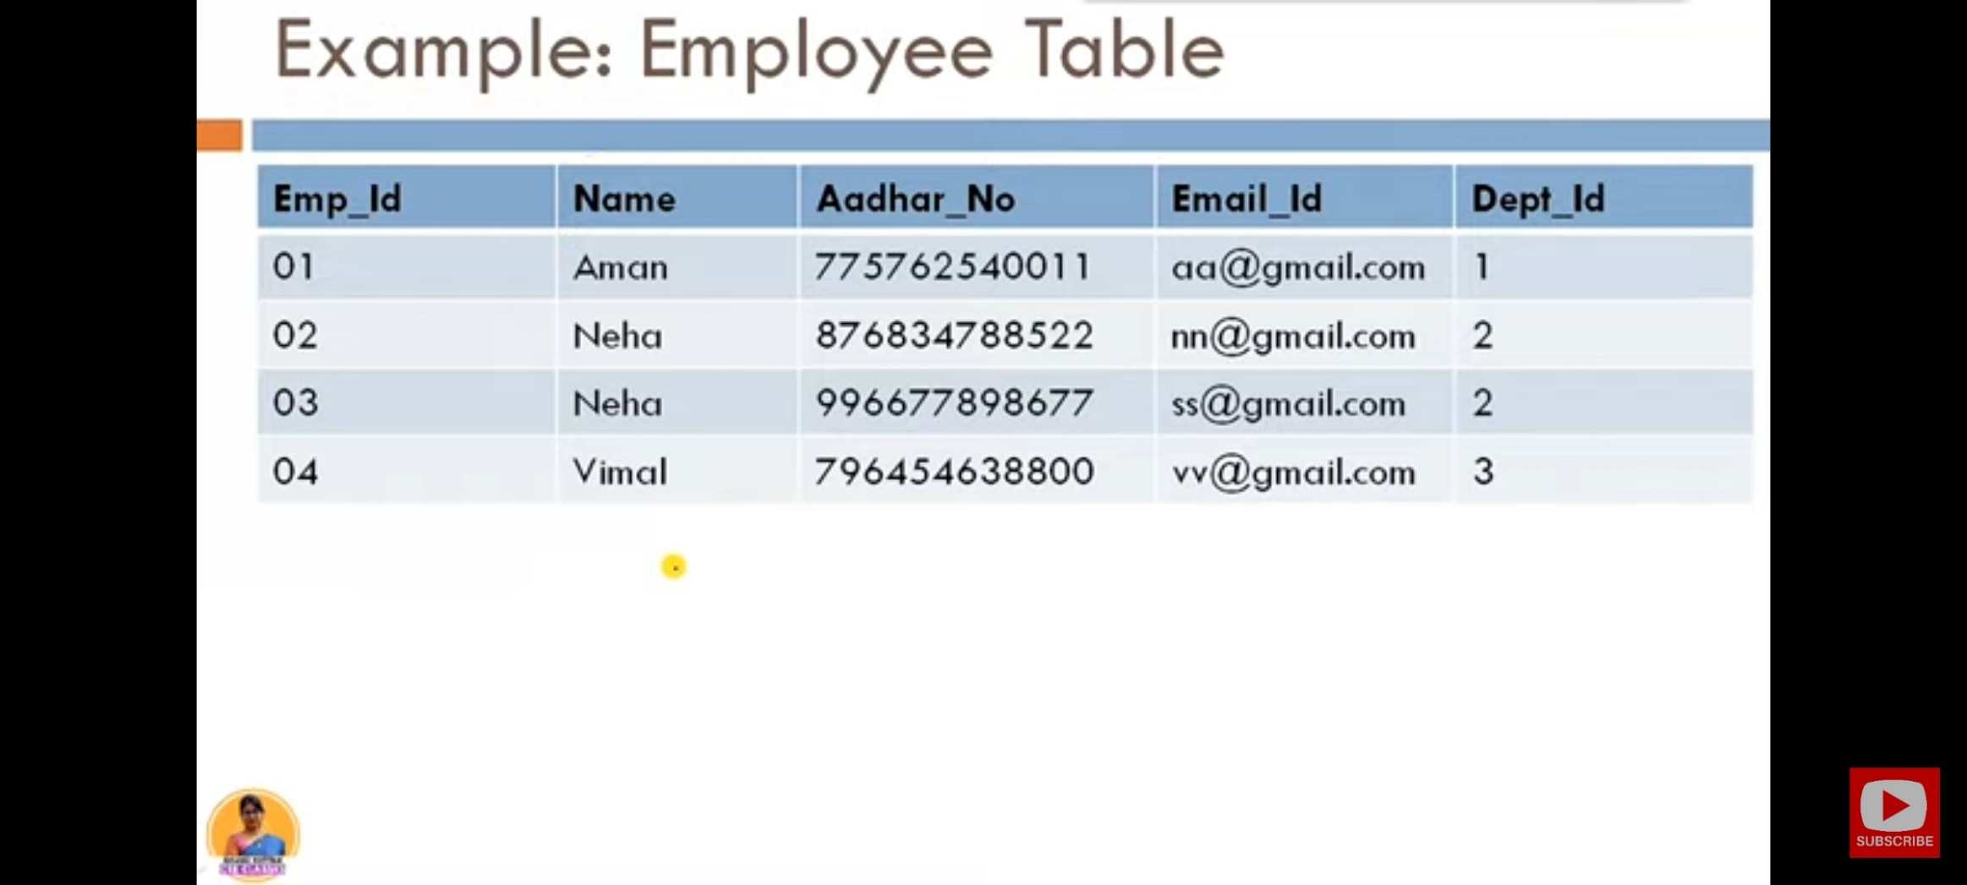

Slide 26


Slide 27
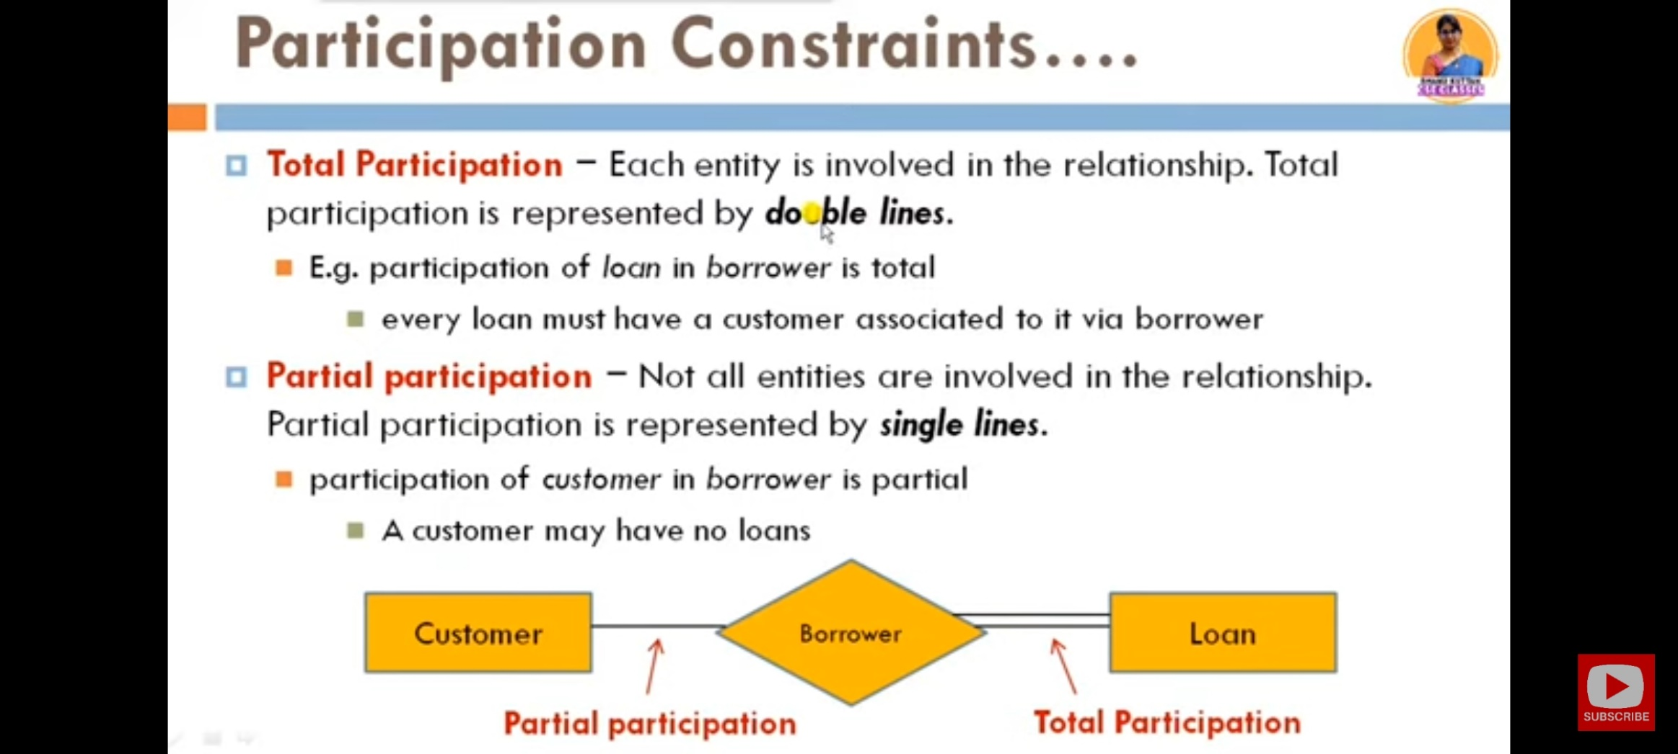

Slide 28
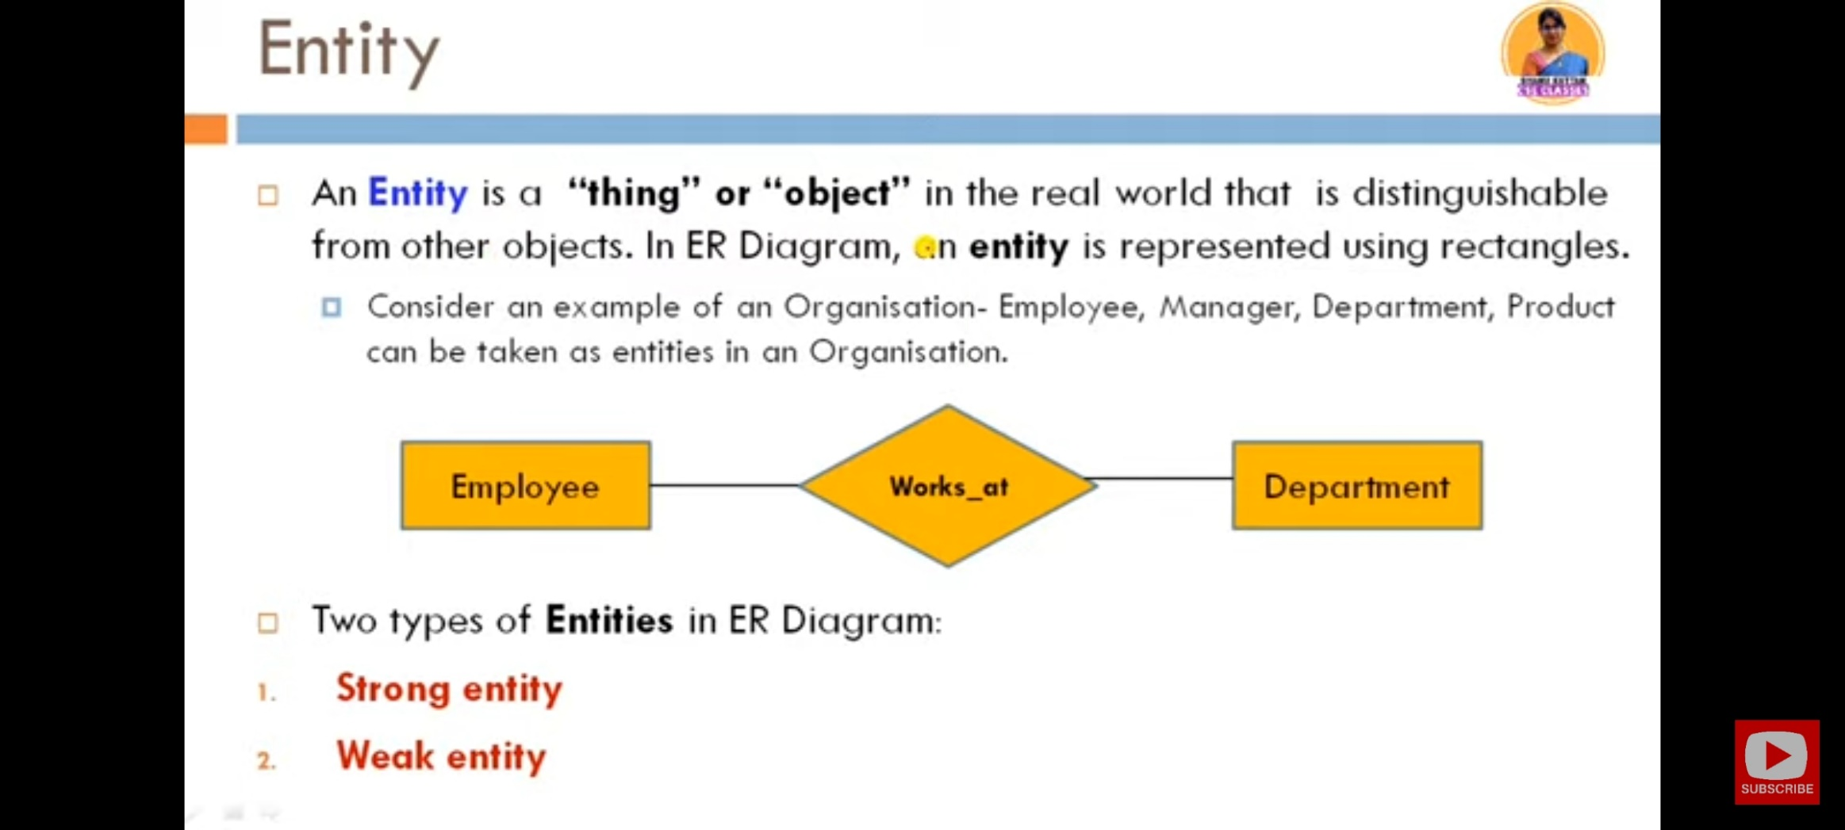

Slide 29
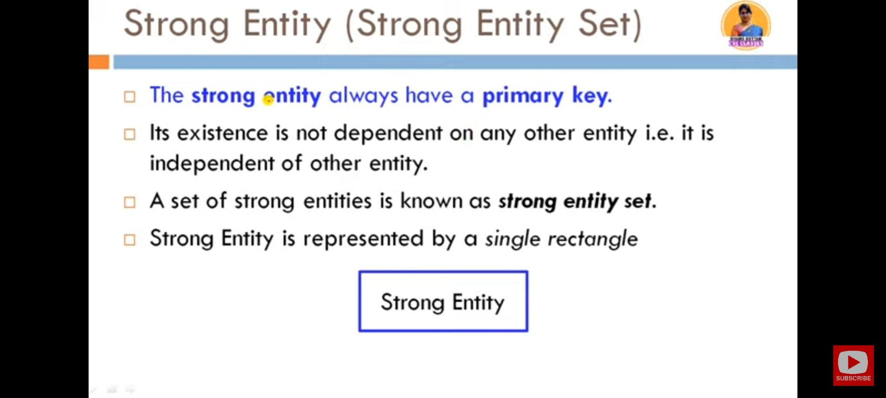

Slide 30
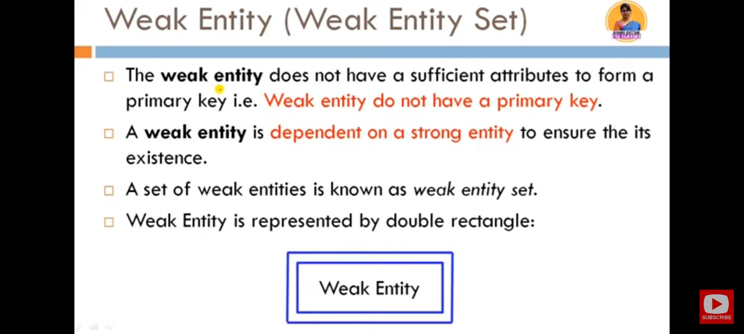

Slide 31
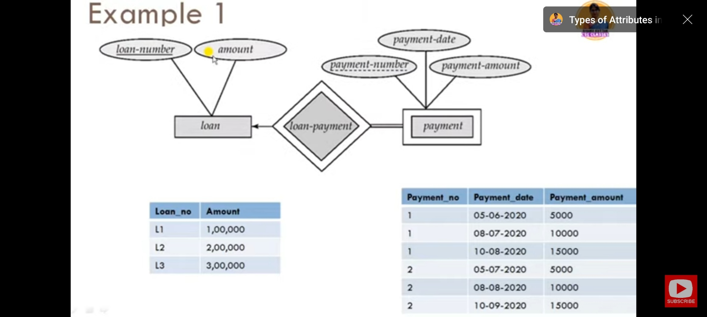

Slide 32
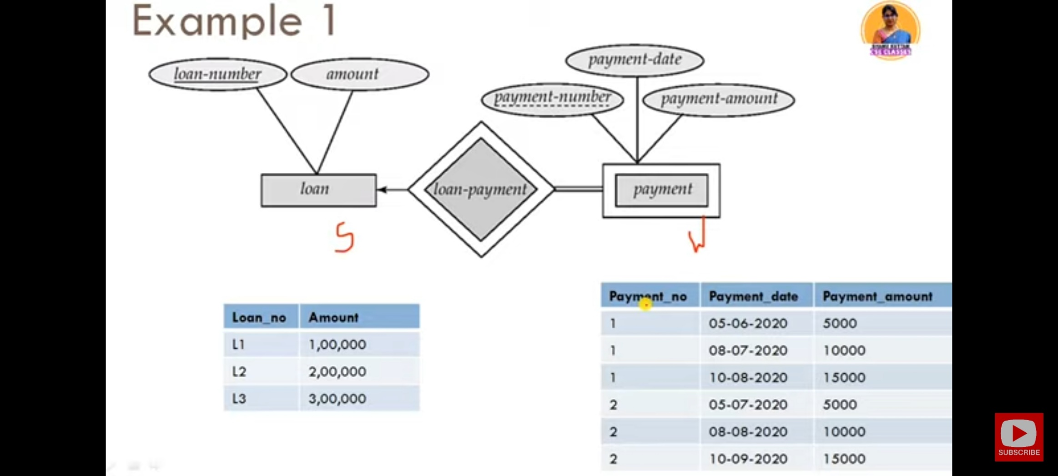

Slide 33


Slide 34
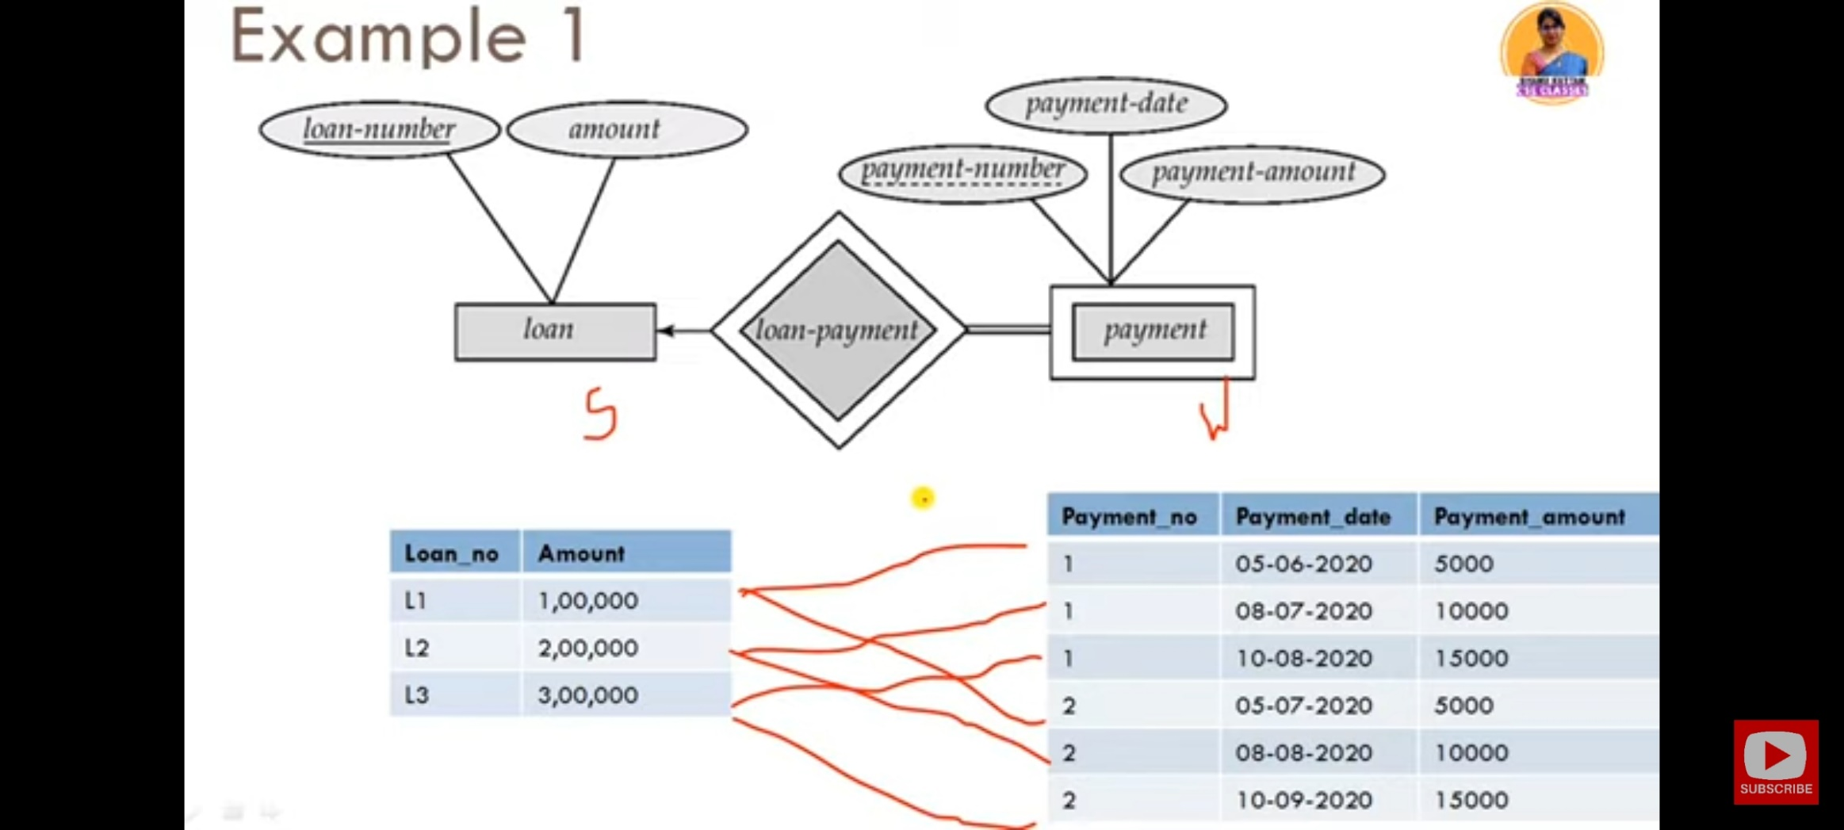

Slide 35
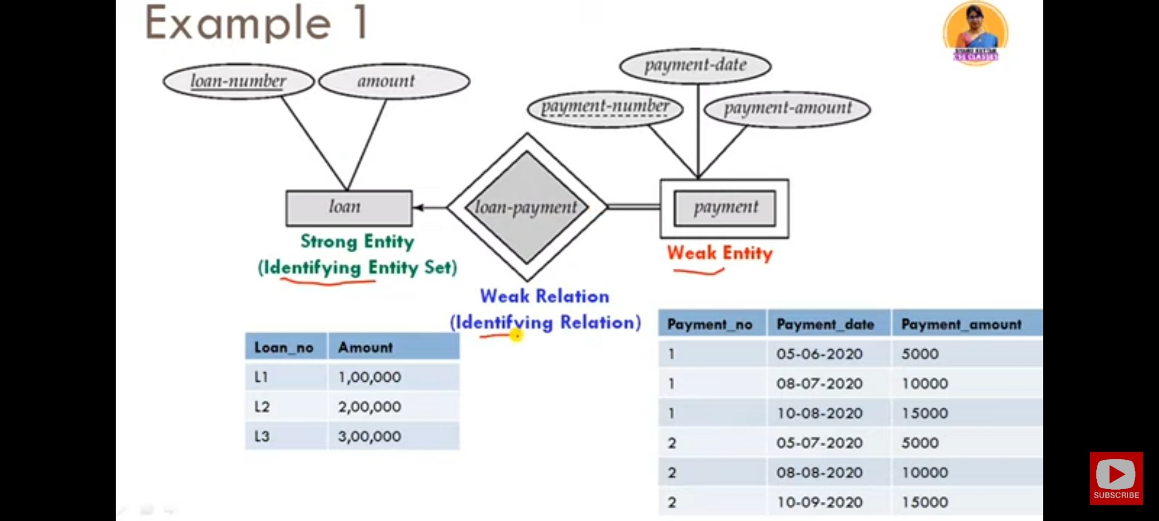

Slide 36
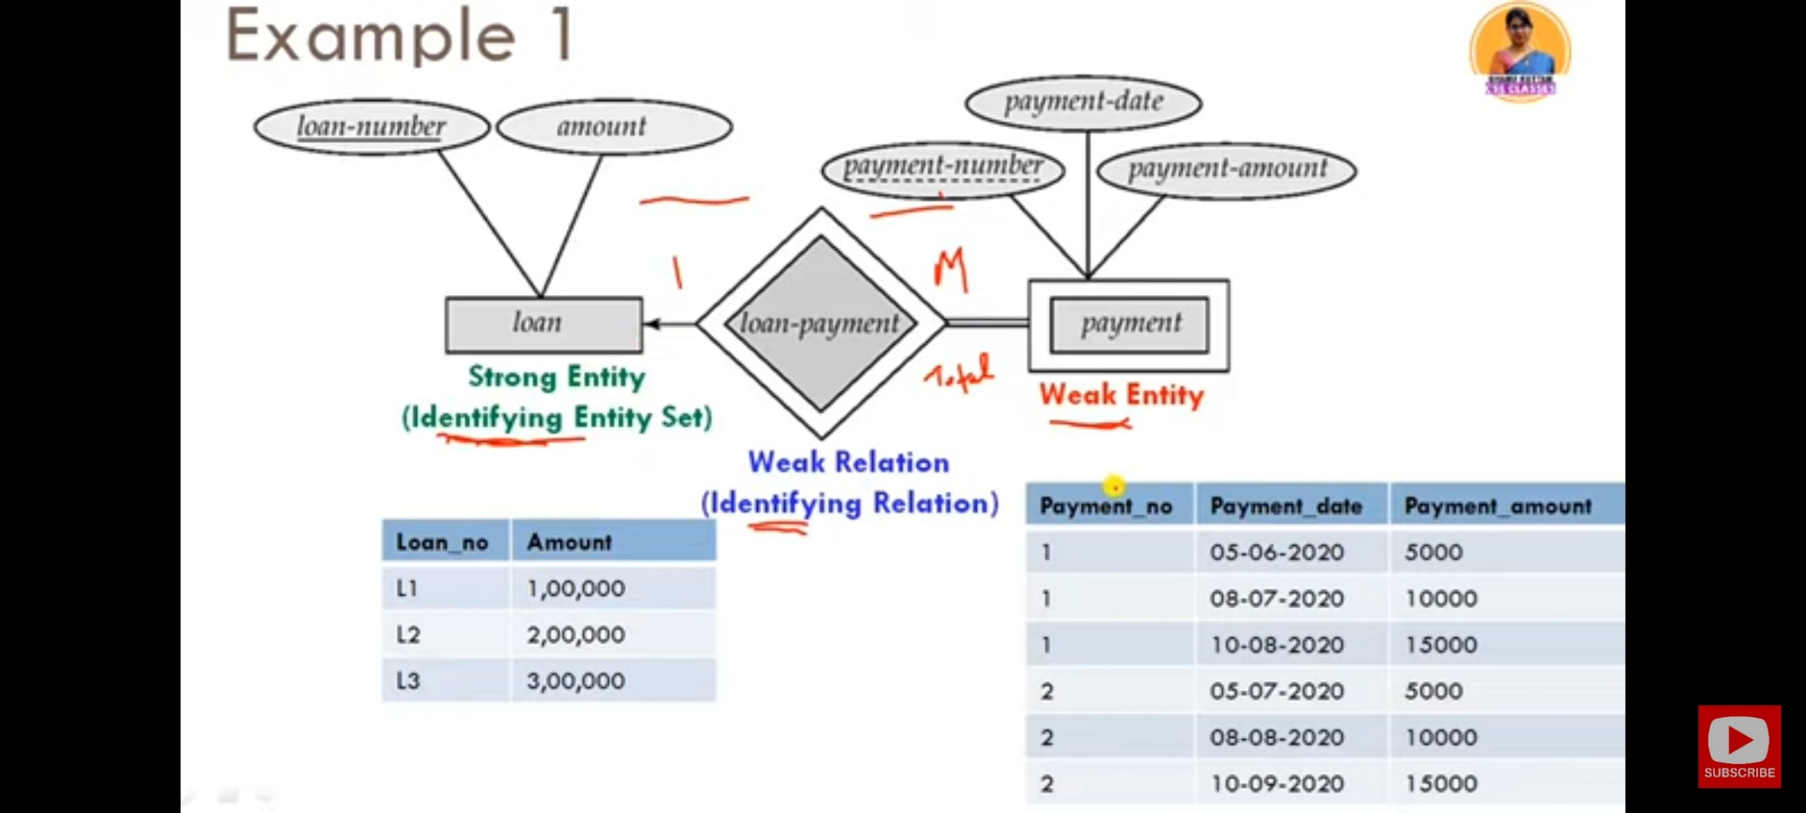

Slide 37
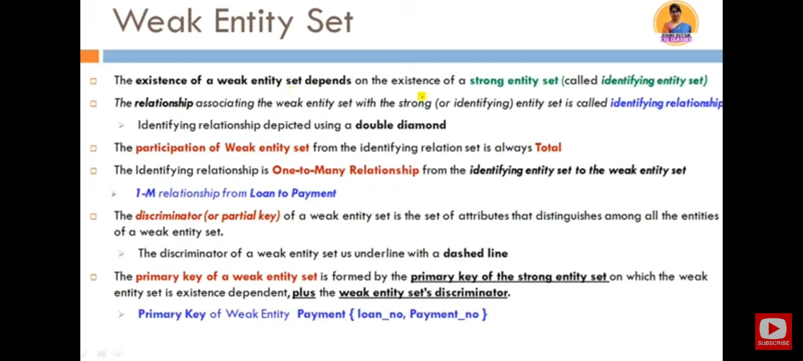

Slide 38
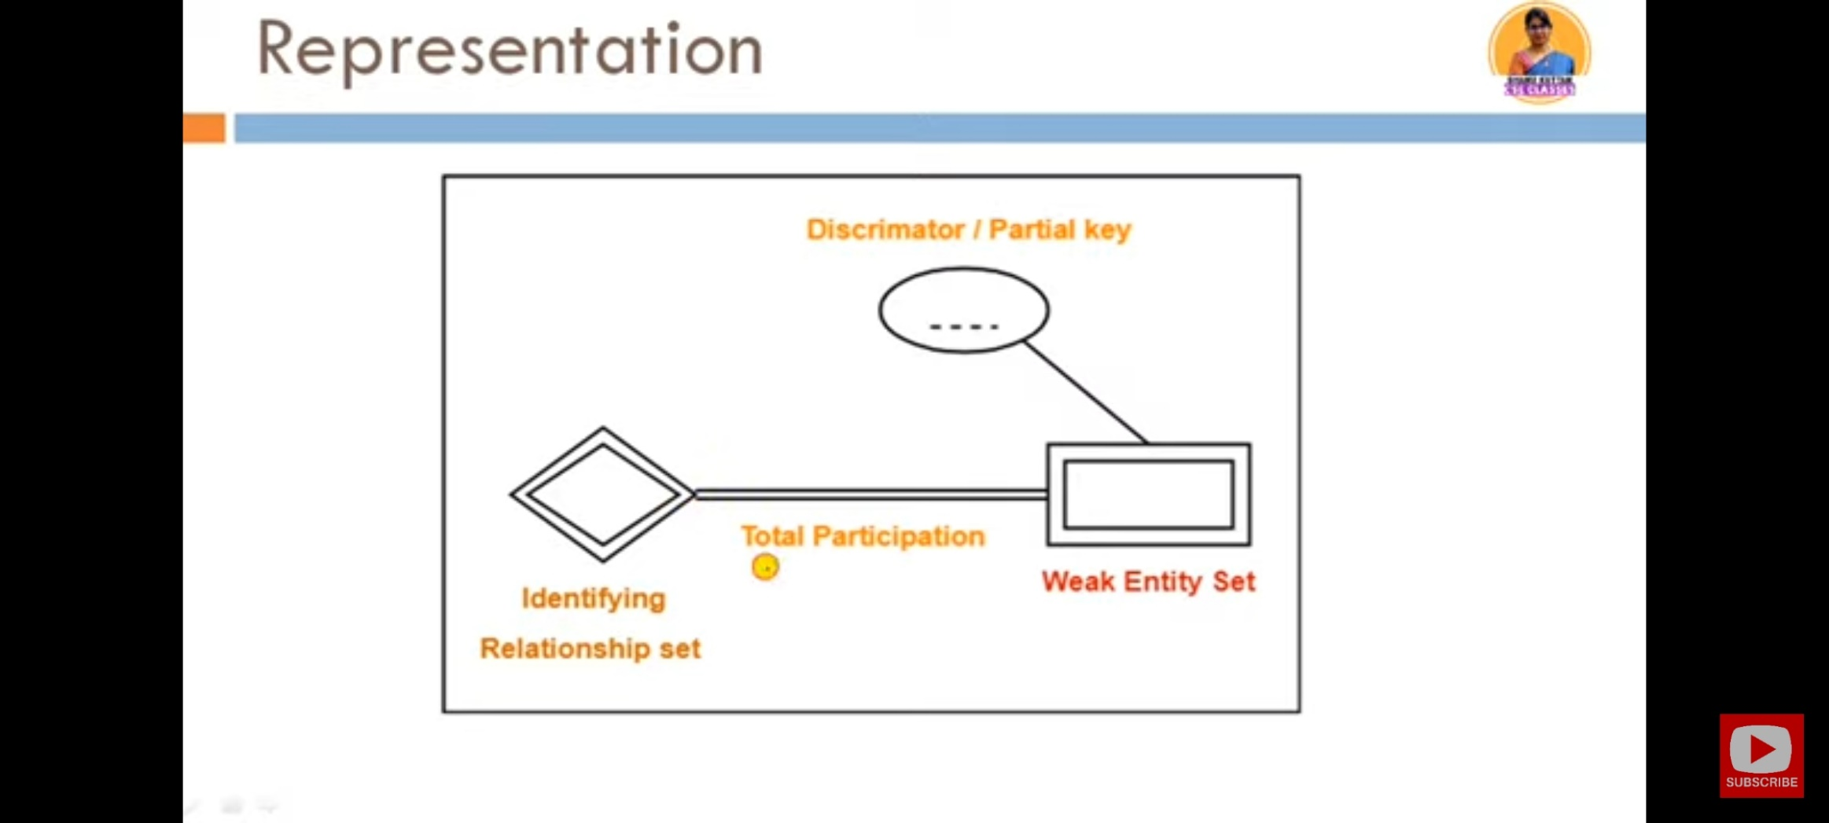

Slide 39
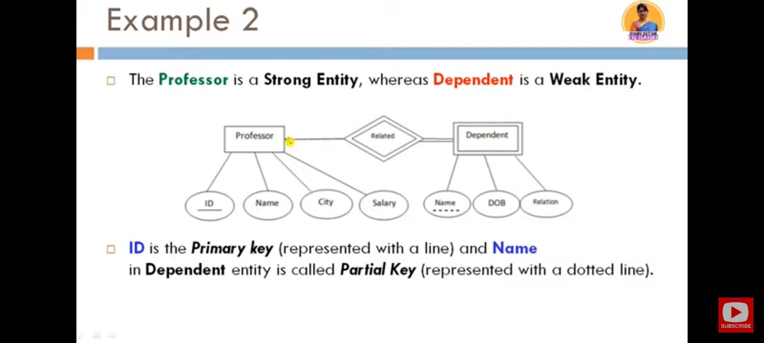

Slide 40
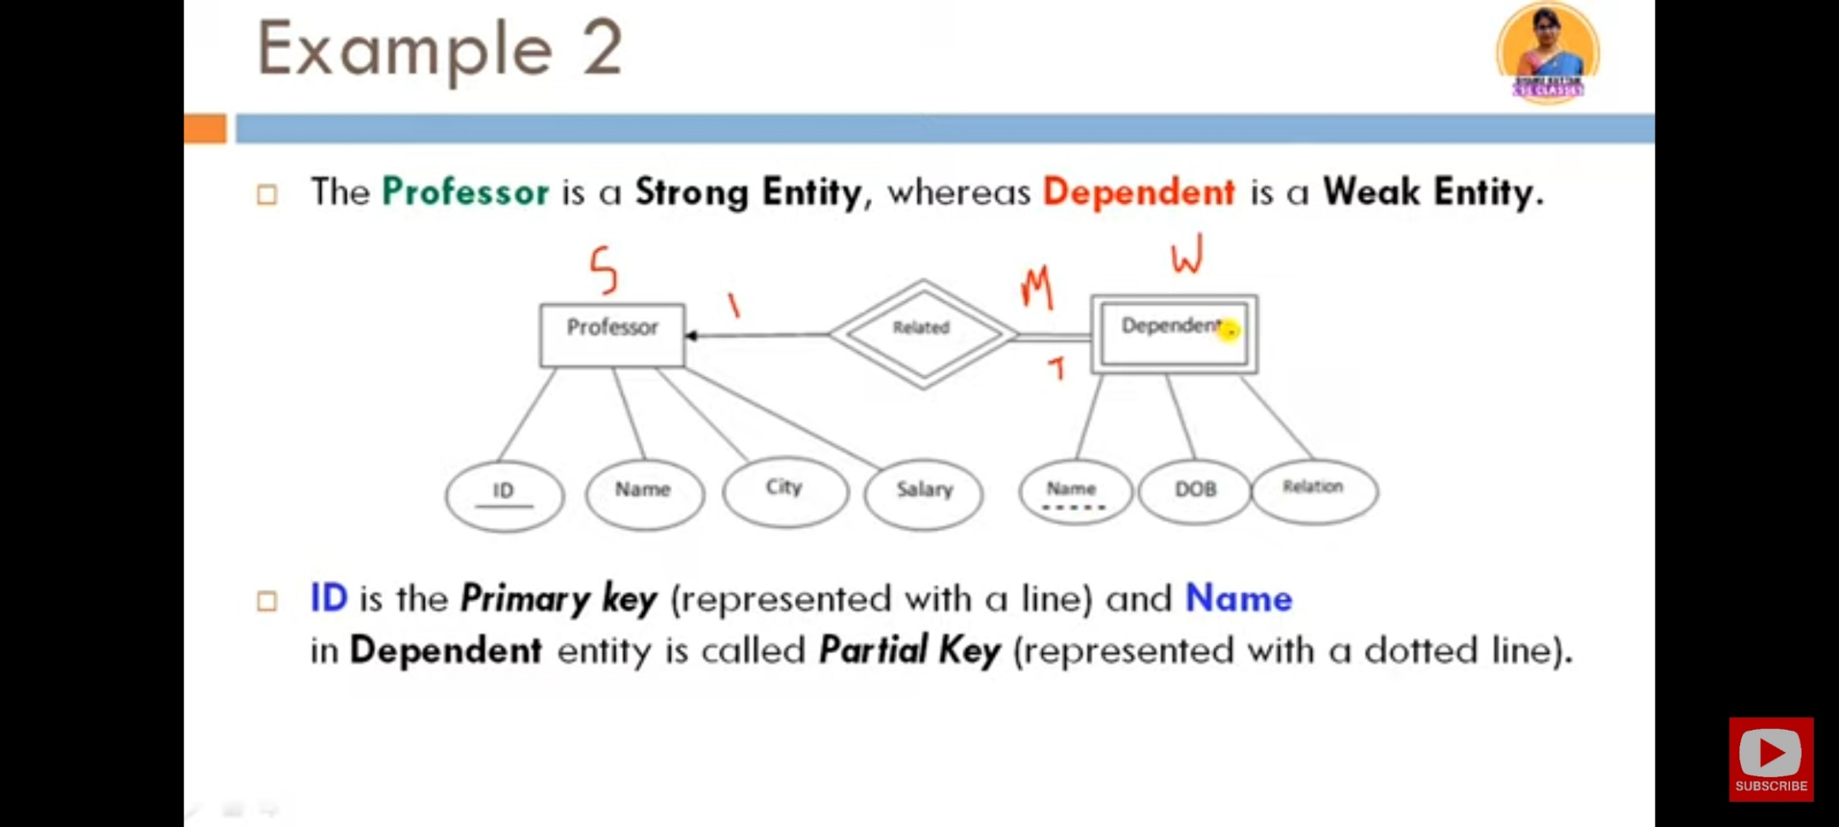

Slide 41
